Slide 1
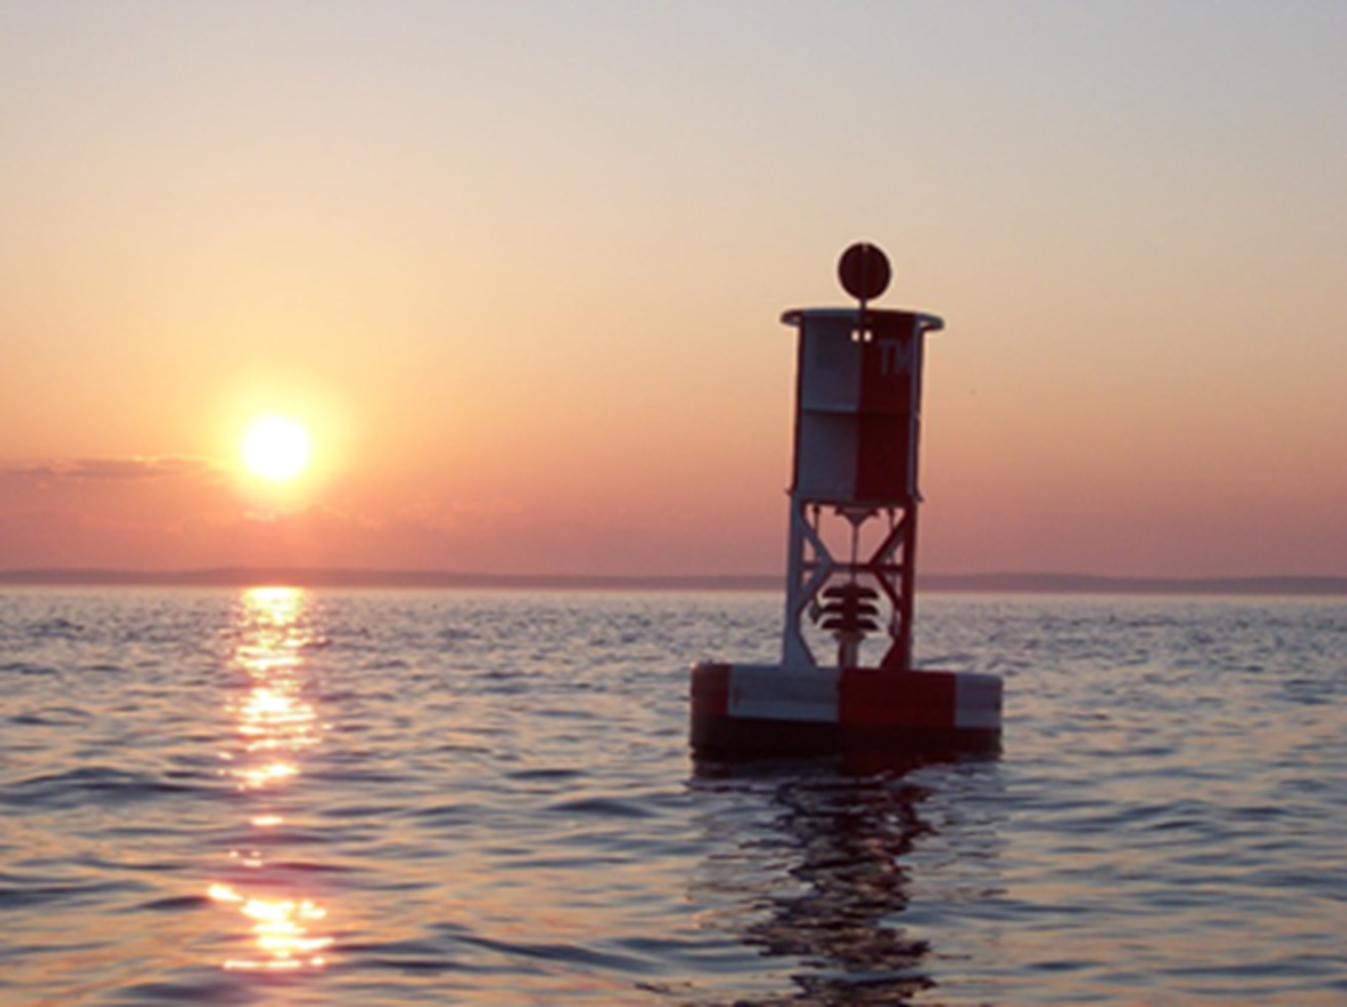
Sunset of NOAA Raster Chart Production
Arctic Regional Hydrographic Commission
September, 2019

Slide 3
Time Scales of Navigation Information 2010
Vessel Positions
Marine Safety Info
Weather
Navaids
Navigation Hazards
Channel Condition
Bathymetry
Shoreline
Tides and Currents
Seconds
Minutes
Hours
Days
Weeks
Months
Years
Decades
NAVTEX
AIS
RadioFax
Notice to Mariners
Charts and Pubs
Broadcast NTM
^{Office of Coast Survey}
National Oceanic and Atmospheric Administration
Notes:
NOAA’s Office of Coast Survey (OCS) is releasing the final version of the National Charting Plan that provides chart users with a better understanding of what to expect in the future of nautical charts.
The changes described in the plan will allow OCS to be more responsive to the evolution of charting and better address the public’s need for navigation data over the next several years. The plan outlines a suite of products that are more useful and safer to navigate with by providing more precise, higher-resolution charts with the most up-to-date navigation information possible.
The comment period to solicit stakeholder feedback on changes to NOAA’s future nautical chart products was open from March 1st, 2017 to July 1st, 2017.
This final version of the plan has been developed since the closure of the public comment period, and addresses and clarifies comments NOAA received.

Slide 4
Time Scales of Navigation Information 2025
Vessel Positions
Real Time Obs.
Marine Safety Info
Wind and Waves
Tides and Currents
Ice Conditions
Navigation Hazards
Navaids
Channel Condition
Bathymetry
Shoreline
Regulations
Seconds
Minutes
Hours
Days
Weeks
Months
Years
Decades
AIS
Dynamic Nav Services
Digital Charts, “Pubs,” Overlays
^{Office of Coast Survey}
National Oceanic and Atmospheric Administration
Notes:
NOAA’s Office of Coast Survey (OCS) is releasing the final version of the National Charting Plan that provides chart users with a better understanding of what to expect in the future of nautical charts.
The changes described in the plan will allow OCS to be more responsive to the evolution of charting and better address the public’s need for navigation data over the next several years. The plan outlines a suite of products that are more useful and safer to navigate with by providing more precise, higher-resolution charts with the most up-to-date navigation information possible.
The comment period to solicit stakeholder feedback on changes to NOAA’s future nautical chart products was open from March 1st, 2017 to July 1st, 2017.
This final version of the plan has been developed since the closure of the public comment period, and addresses and clarifies comments NOAA received.

Slide 5
Stop All Raster Chart Production by 2024
“Sunsetting NOAA Raster Charts” plan - Aug 2019
Coordinate with partners – 2019/2020
USCG, USACE, NGA, international regional partners
Raster Chart Stakeholder Engagement – 2019/2020
Paper and raster chart users
POD paper chart distributors
After-market chart services
Start canceling raster charts – 2020
Corresponding products will be canceled together
Paper, RCN, RNC Tiles, Booklet Charts, PDFs
Focus resources on improving quality and coverage of the ENC product
Primarily carried out as part of ENC rescheming
Accelerate development and improvement of NOAA Custom Chart web service

Slide 6
Immediate Production Changes
Suspend application of routine data (CM) to raster charts
Such as new hydrographic and shoreline surveys
Continue applying Critical Corrections and DTONs to raster charts
Continue transition to Project Depths in USACE channels on Raster Charts
To Complete by Oct 1, 2019
Stop updating non-postable data
NP data will be retained in the NIS – for the time being

Slide 7
Planned End State 2024
3000-5000 ENCs, updated weekly
No traditional paper charts
No chart corrections via NTM
ENC scales reduced to 8
All ENCs available by “Custom Chart” process as printable charts
Suitable for use for backup to electronic navigation.
Whole chart and thematic web mapping services

